Slide 1
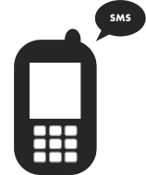
Testing the combination of Behaviour change technique for smoking cessation: a Factorial randomised trial in Thailand
Pritaporn Kingkaew, B.Pharm, MSc (Health Economics), PhD candidate

Slide 2
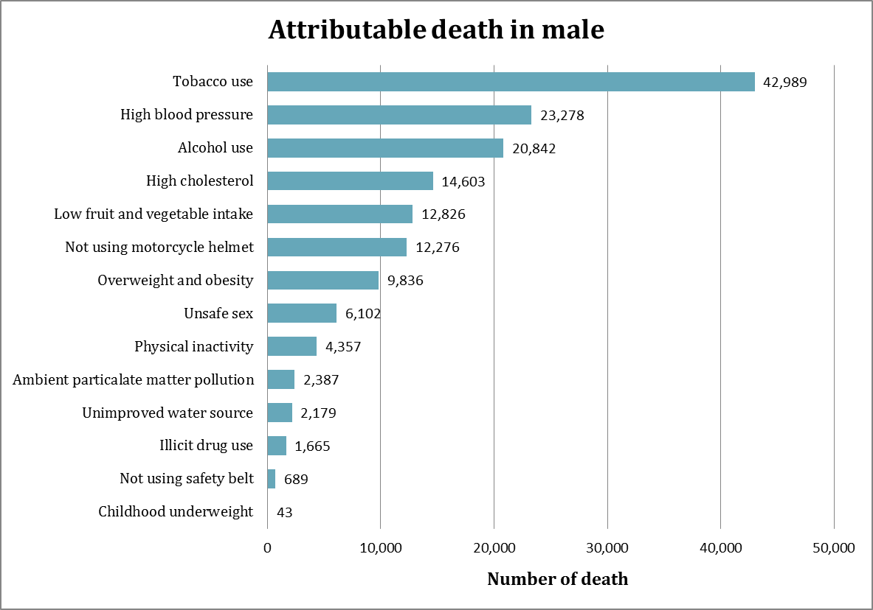
Why stop smoking Matter?
1 in 6 deaths²
In 2017, smoking prevalence was 19% in Thai population aged 15 years and above (38% in male and 2% in female)¹.
Thailand National Quitline provides a countrywide telephone counselling service for smoking cessation free of charge.
Around 60% of the callers did not receive complete quit counselling and/or follow-up calls³.
Sources: ¹National Statistical Office of Thailand. Smoking and Drinking Behaviour Survey, 2017; ²Thailand Burden of Disease. Comparative Risk Assessment, 2009; ³Meeyai A et al. 2015 Tob Control 24(5): 481-488
Notes:
In 2009, estimates suggested that around one in six deaths (43,000) of Thai males were caused by smoking².

Slide 3



Target groups
1. Thailand National Quitline:
Improve current service providing by adding on automatic SMS
Provide evidence-based for decision making
2. ThaiHealth Promotion Foundation (สสส.):
Improve the way of thinking in mass media communication
3. The Ministry of Public Health:
Rigorous evaluation of public health programme using randomised controlled trial design prior to programme implementation

Slide 4
Methods: Study design
Study design: 2x2x2 factorial randomised controlled trial (factorial RCT) -> 8 intervention groups
Participants:
Interventions:
Outcome: 7-day point prevalence smoking abstinence at 1-month follow-up
Thai smokers who wanted to quit smoking
Own a mobile phone with at least the ability to send and receive SMS
Be able to read and write Thai
Provision of informed consent
Text messages: Automated set of text messages, twice a day at 7:00 am and 4:00 pm for 30 days (60 text messages)
Usual care: Participants from Quitline received follow-up telephone calls for emotional support at 7-day, 15-day, and 1-month intervals

Slide 5
2 x 2 x 2 Full factorial design
Experimental conditions | Intervention components (Factors)
 | Capability | Opportunity | Motivation
1: Placebo | No | No | No
2: C | Yes | No | No
3: O | No | Yes | No
4: M | No | No | Yes
5: CO | Yes | Yes | No
6: CM | Yes | No | Yes
7: OM | No | Yes | Yes
8: COM | Yes | Yes | Yes

Slide 6

Media advertisement

Slide 7

Important baseline characteristics (N=1571)










90% Male










51% Single, widowers, divorced










81% Employed










81% Daily smokers










83% High intention-to-quit score

Slide 8
Important baseline characteristics










91% Try to quit in the past 6 months










96% Willing to quit in the next month










87% Owned smartphone










47% Used SMS










83% Used instant messages










15% Used health app

Slide 9
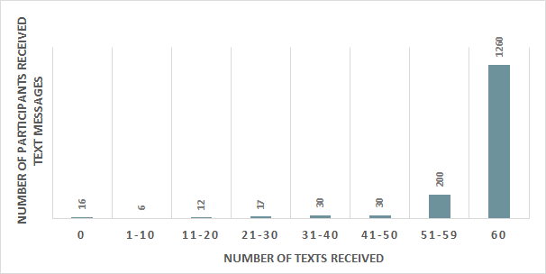
Results: Intervention fidelity (N = 1571)
80% received 60 intended text messages
94% reported receiving the text


Slide 10
Results: Technology engagement
Open & Read
94%
0% 10% 20% 30% 40% 50% 60% 70% 80% 90% 100%
LIKE
51
0 10 20 30 40 50 60
SHARE
14%
0% 10% 20% 30% 40% 50% 60% 70% 80% 90% 100%
SUBSCRIBE
6.6
0 1 2 3 4 5 6 7 8 9 10
Notes:
Like = 51.2, Share = 14.8%, Subscribe = 6.66
C, M, CO

Slide 11
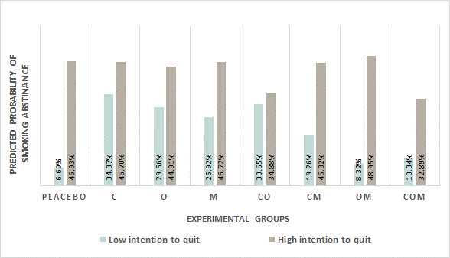
Results: Predicted probability of smoking abstinence at 1 month
Note: logistic regression model adjusted with age group, intention-to-quit group, and interaction terms between intervention groups (C*O, C*M, O*M, and C*O*M)

Slide 12

Next step
Tailored health-related SMS to meet the need
Automatic on-demand support at your fingertips
Share existing SMS to Quitline and other mobile apps
Current partner:

Slide 13

Acknowledgement
Supervisors
  Dr. Liz Glidewell, Leeds Institute of Health Sciences, University of Leeds,
  Dr. Rebecca Walwyn, Leeds Institute of Clinical Trials Research, University of Leeds,
  Prof. Jeremy C. Wyatt, Wessex Institute of Health & Research, Faculty of Medicine, University of Southampton
Thailand National Quitline: Prof. Jintana Yunibhand and her amazing quitline team
Funders: Health Promotion Economic Evaluation Collaborative Center and Thai Health Promotion Foundation

Slide 14

Thank you for listening
If you have any comments or suggestions,
please email to pritaporn.k@hitap.net

