Slide 1



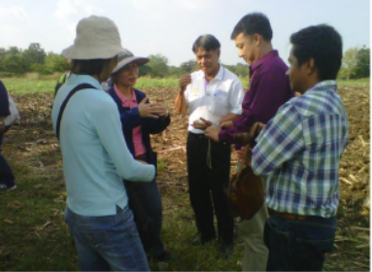
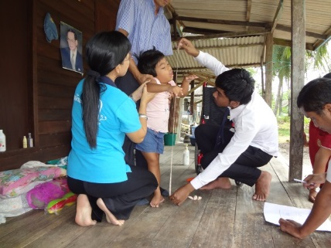
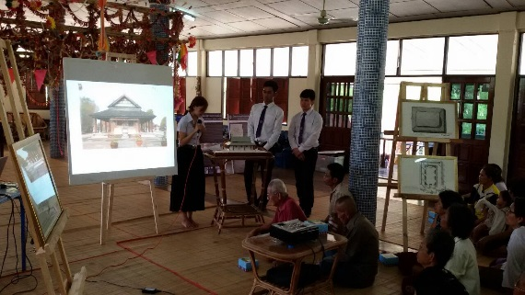
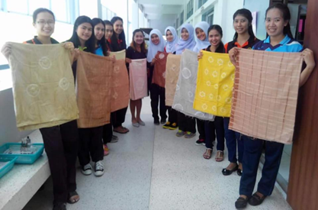
Higher Education in Thailand 4.0 Era
Presented by Dr. Suphat Champatong
Secretary-General for Higher Education Commission
1 September 2018
ATPER Annual Meeting
Notes:
http://www.bic.moe.go.th/newth/images/stories/book/ed-eng-series/intro-ed08.pdf

Slide 2
1. Thai Higher Education
Higher Education in Thailand 4.0 Era

Slide 3

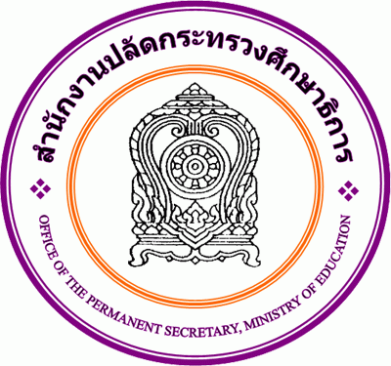


Ministry of Education : 5 Core Organizations in Administrative Structure
Ministry of Education
Office of the Minister
Office of the Permanent Secretary
Office of the Education Council
Office of the Basic Education Commission
Office of the Vocational Education Commission
Office of the Higher Education Commission
HEIs
HEIs
HEIs
(หน้า 3)
(Page 3)

Slide 4


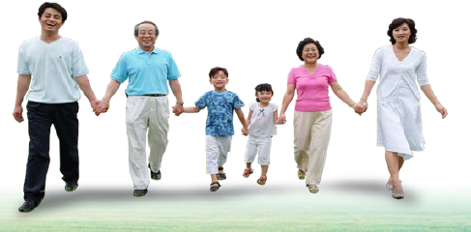
4 Missions of Higher Education
Global and national situations have changed (economy, society, culture and politics)
Roles of HEIs
Producing
graduates
Conducting
research
Rendering
academic
services
Preserving
and promoting
art and
culture
Thailand has to engage in activities in response to external catalysts so as to be able to compete in every situation.
CREATE : Knowledge, Graduates, Environment
Society expects that HEIs produce quality manpower who would drive country out of crisis by their wisdom. It is because HEIs is the colossal source of academic resources.
4
(Page 4)

Slide 5
The Administrative Structure of Higher Education
155 HEIs (degree-granting institutions) and 1 Institute of Community Colleges
Thai Qualifications Framework
for Higher Education: TQF
(As of 30 Aug 2018)
(Specialized Institutions)
Minister of Education
Institutions which operate under
other parental organizations, but
adopt the Thai Qualifications Framework for Higher Education,
e.g. Institute of Physical Education/ Chulachomklao Royal Military Academy/ Bunditpatanasilpa Institute.
Higher Education Commission (HEC)
Office of the Higher Education Commission (OHEC)
TQF
TQF
TQF
Public HEIs (82)*
- Public universities (12)
- Rajabhat Universities (38)
- Rajamangala Universities of Technology (9)
Private HEIs (73)
Universities (42)
Colleges (20)
Institutes (11)
Institute of Community Colleges (1)
(20 Community Colleges
: Associate Degree Level)
Public autonomous universities (24)
(Page 5)

Slide 6
Number of Students in HEIs under OHEC’s Supervision (Academic Year 2017)
Reference :
Higher Educational Information Centre, OHEC (19 July 2018)
Private Institutions
Private Colleges
Private Universities
Type of Higher Education Institutions
Remarks:
Student status (registration with additional credits)
and maintaining student status (register without additional credits)
Community College
Rajabhat Universities
Open Admission Universities
Autonomous Universities
Rajamangala University of Technology
Public Universities

Slide 7

Information on Staff in Public HEIs
HEIs | Government Official | University Staff | Government Employee | Permanent Employee | Temporary Employee | Others | Total
1. Public Universities | 15,590 | 30,275 | 803 | 4,923 | 15,387 | 2,145 | 69,123 (37.45%)
2. Public Autonomous Universities | 4,767 | 47,359 | 43 | 7,153 | 10,724 | 173 | 70,219 (38.05%)
3. Rajabhat Universities | 4,853 | 18,525 | 961 | 1,120 | 5,192 | 160 | 30,811 (16.70%)
4. Rajamangala Universities of Technology | 4,256 | 5,122 | 395 | 693 | 3,876 | 45 | 14,387 (7.80%)
Total | 29,466 | 101,281 | 2,202 | 13,889 | 35,179 | 2,523 | 184,540
Percentage | 15.97% | 54.88% | 1.19% | 7.53% | 19.06% | 1.37% | 100.00%
As of 30 September 2015
(Page 7)

Slide 8
Number of Staff in HEIs Classified by Type of Staff and Category (Academic and Supporting Staff)
Academic
Supporting
(Page 8)

Slide 9





Reference : Budget Planning Group, Bureau of Policy and Planning, OHEC
HEIs
Unit : Million Baht
OHEC
Fiscal Year (B.E.)
2011 | 2012 | 2013 | 2014 | 2015 | 2016 | 2017
5.81
28.66
-19.40
-9.95
9.90
-32.43***
6.66
***In 2560 Chulabhorn Royal Academy directly submitted the budget proposal to the Bureau of the Budget.

Slide 10
2. Factors that impact
Thai Higher Education
Higher Education in Thailand 4.0 Era

Slide 11
Trap or Good Intention of the West (Trilling & Fadel, 2009)
More Developed Countries
Research and Technology
Extended Development
Creative Design
Marketing and Sales
Global Supply Chain Management
·
CREATIVE WORK
Leader
Follower
Versatile to change
Learn new skills/technology
Keep pace with new products
Learn new innovation
Self and international communication development
·
ROUTINE WORK
Done by people
Done by Machines
Less Developed Countries
(Page 11)

Slide 12
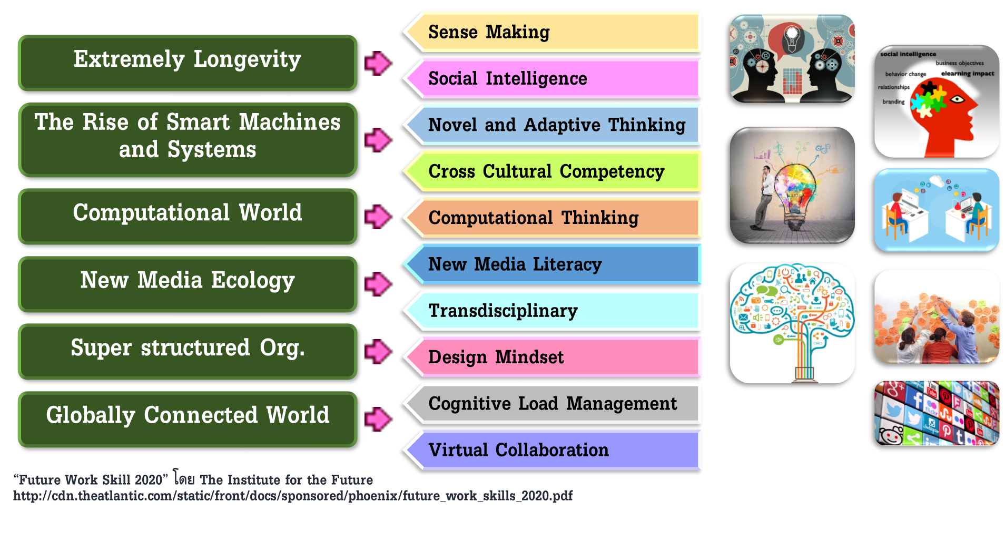
Drivers of Change for the Future
(Page 12)

Slide 13
Population pyramids of Thailand :
Classified by gender and years 2000, 2010, 2020 & 2030

Slide 14
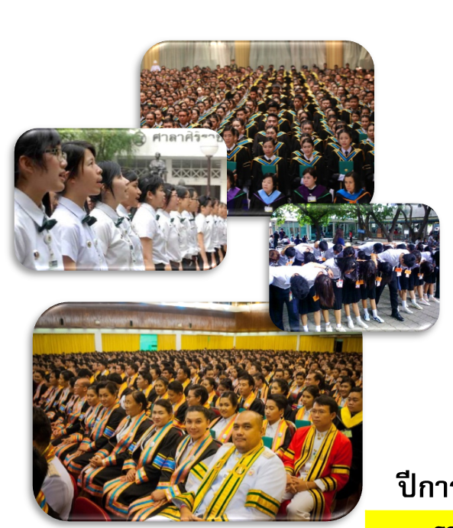
Students in HEIs under OHEC’s Supervision
Number of Students (person)
Academic Year | 2013 | 2014 | 2015 | 2016 | 2017
Total Number of Students | 2,123,594 (1,876,480) | 2,051,147 (1,820,931) | 2,054,262 (1,827,924) | 1,923,743 (1,738,847) | 1,861,081 (1,680,532)
Number of New Enrollment (Bachelor’s Degree) | 487,145 | 506,309 | 490,318 | 433,886 | 401,754
Number of Graduates (Bachelor’s Degree)* | 224,799 | 272,735 | 279,312 | 291,697 | 302,713
Reference :
Higher Educational Information Centre, OHEC (20 July 2018)

Slide 15
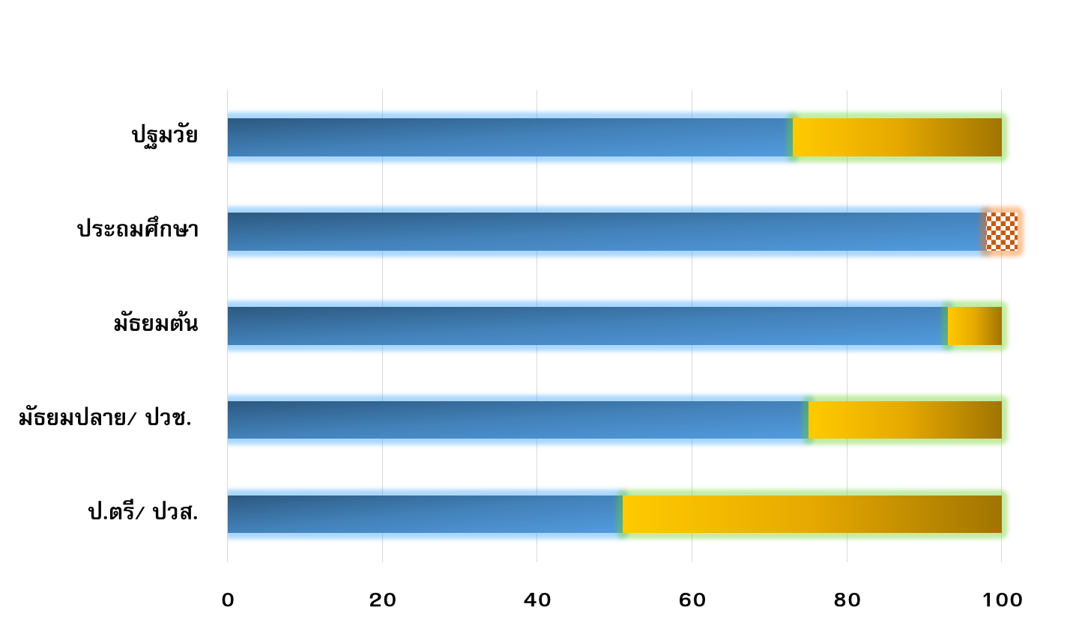
Average Proportion of Thai Citizen’s Enrollment in Education System between 2010-2013
Enroll in education
Early Childhood Education
73%
100%
(4-6 years)
Out-of-school
Primary Education
98%
102%
Non Thai Citizen
(7-12 years)
Lower Secondary Education
93%
100%
(13-15 years)
Upper Secondary Education/
75%
100%
Vocational Certificate
(16-18 years)
Undergraduate Degree/
51%
100%
Diploma
(19-22 years)
(Percentage of Thai Citizens in Each Education Sector)
(Page 15)

Slide 16
Number of Bachelor’s Degree Students in HEIs under OHEC’s Supervision(Academic Year 2014-2017)
Academic Year 2014
Academic Year 2015
Academic Year 2016
Academic Year 2017
1st Year
3rd Year
4th Year
5th Year
6th Year and Above
(Page 16)
2nd Year

Slide 17
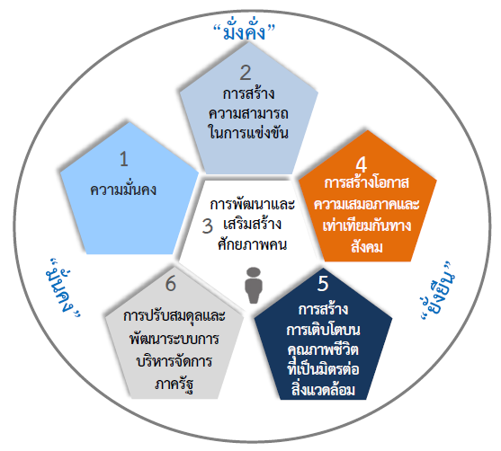
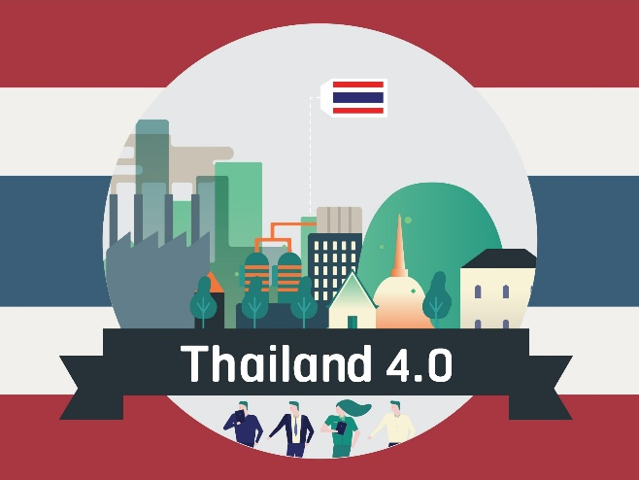





Factors that impact Thai Higher Education
1. Future scenarios which have an impact on Thai Higher Education
2. Thailand's 20-Year National Strategy
3. Thailand 4.0
Prosperity
Demographic change
Future youth, students, and graduates
2
Competitiveness Enhancement
1
Security
4
Social Equity
Labor market change
3
Human Resource Development
Familiarization with knowledge-based economy
Stability
Sustainability
6
Rebalancing and Public Sector Development
5
Green Growth
Decentralization
Technology and IT era
Changes in global and ASEAN contexts
Social violence and conflict
Major mechanism to help solve the country’s problems and crises by using knowledge to guide country’s development
Thai HEIs
(Page 17)
Notes:
http://thailand.prd.go.th/ewt_news.php?nid=3578

Slide 18
University 4.0
Platform for the National Agenda
Adapted from Professor Udom Kachintorn,
President Mahidol University
Thailand
Research
Organizations
Network
Government
Budget
Research
Funding
University 4.0
COEs
(OHEC)
(TRON)
Overseas Universities
Global University
(Leader)
Strengthening
Strengthening
Partnership
Paticipating
Univ.
Universities for
Community
Development
Paticipating
Univ.
University 4.0
Will not leave anyone behind.
Specialised
Universities
Paticipating
Univ.
Paticipating
Univ.
Province/
Area
Paticipating
Univ.
Science Park
Innopolis Innovation Hubs
ect.
Collaboration, Research Agenda
and
Utilization
Development of the Area / Region
Strength and Partnership
Industry 4.0
Society/People 4.0
(Inclusive)
Vocational
Education
Private
Sector /
Startup
Financial
institution
Economy 4.0
(Competitive)
(Page 18)

Slide 19
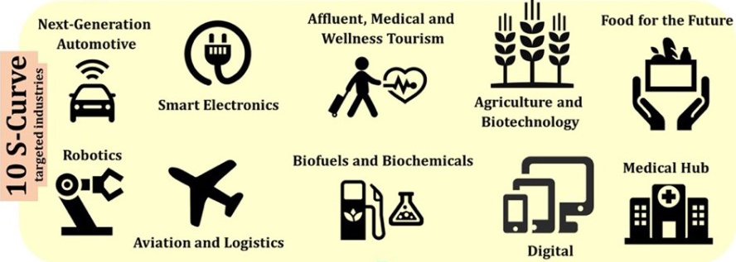
10 Targeted Industries
Source : https://www.thailand-business-news.com/visa/67898-thailands-new-smart-visa-support-thailand-4-0-targeted-industries.html
(Page 19)

Slide 20

Public University (82)
e.g. CU, MU, KU
Private University (73)
e.g. VISTEC, UTCC, ABAC
Foreign Higher Education
Institutions
e.g. Carnegie Mellon University (CMKL),
National Taiwan University
(Amata University)
Principal Investigator
Senior Mentor
Senior Fellow
Researcher
University
Postdoc
Thailand 4.0
OHEC- Research Grant
Industry
Eastern Economic Corridor
Metropolitan Rapid Transit
Smart City
Air/Maritime Transport
etc.
Newton Fund
(Up to 5M THB/Project)
Talent Mobility Project
(Up to 0.6M THB/Project)
Military R&D
(Up to 10M THB/Project)
Young Researcher Project
(Up to 0.3M THB/Project)
MED Tech Excellence Fund
(Up to 2M THB/Project)
Center of Excellence
Commercial research Project
Community Research Project
University Business Incubator (UBI)
(Page 20)

Slide 21
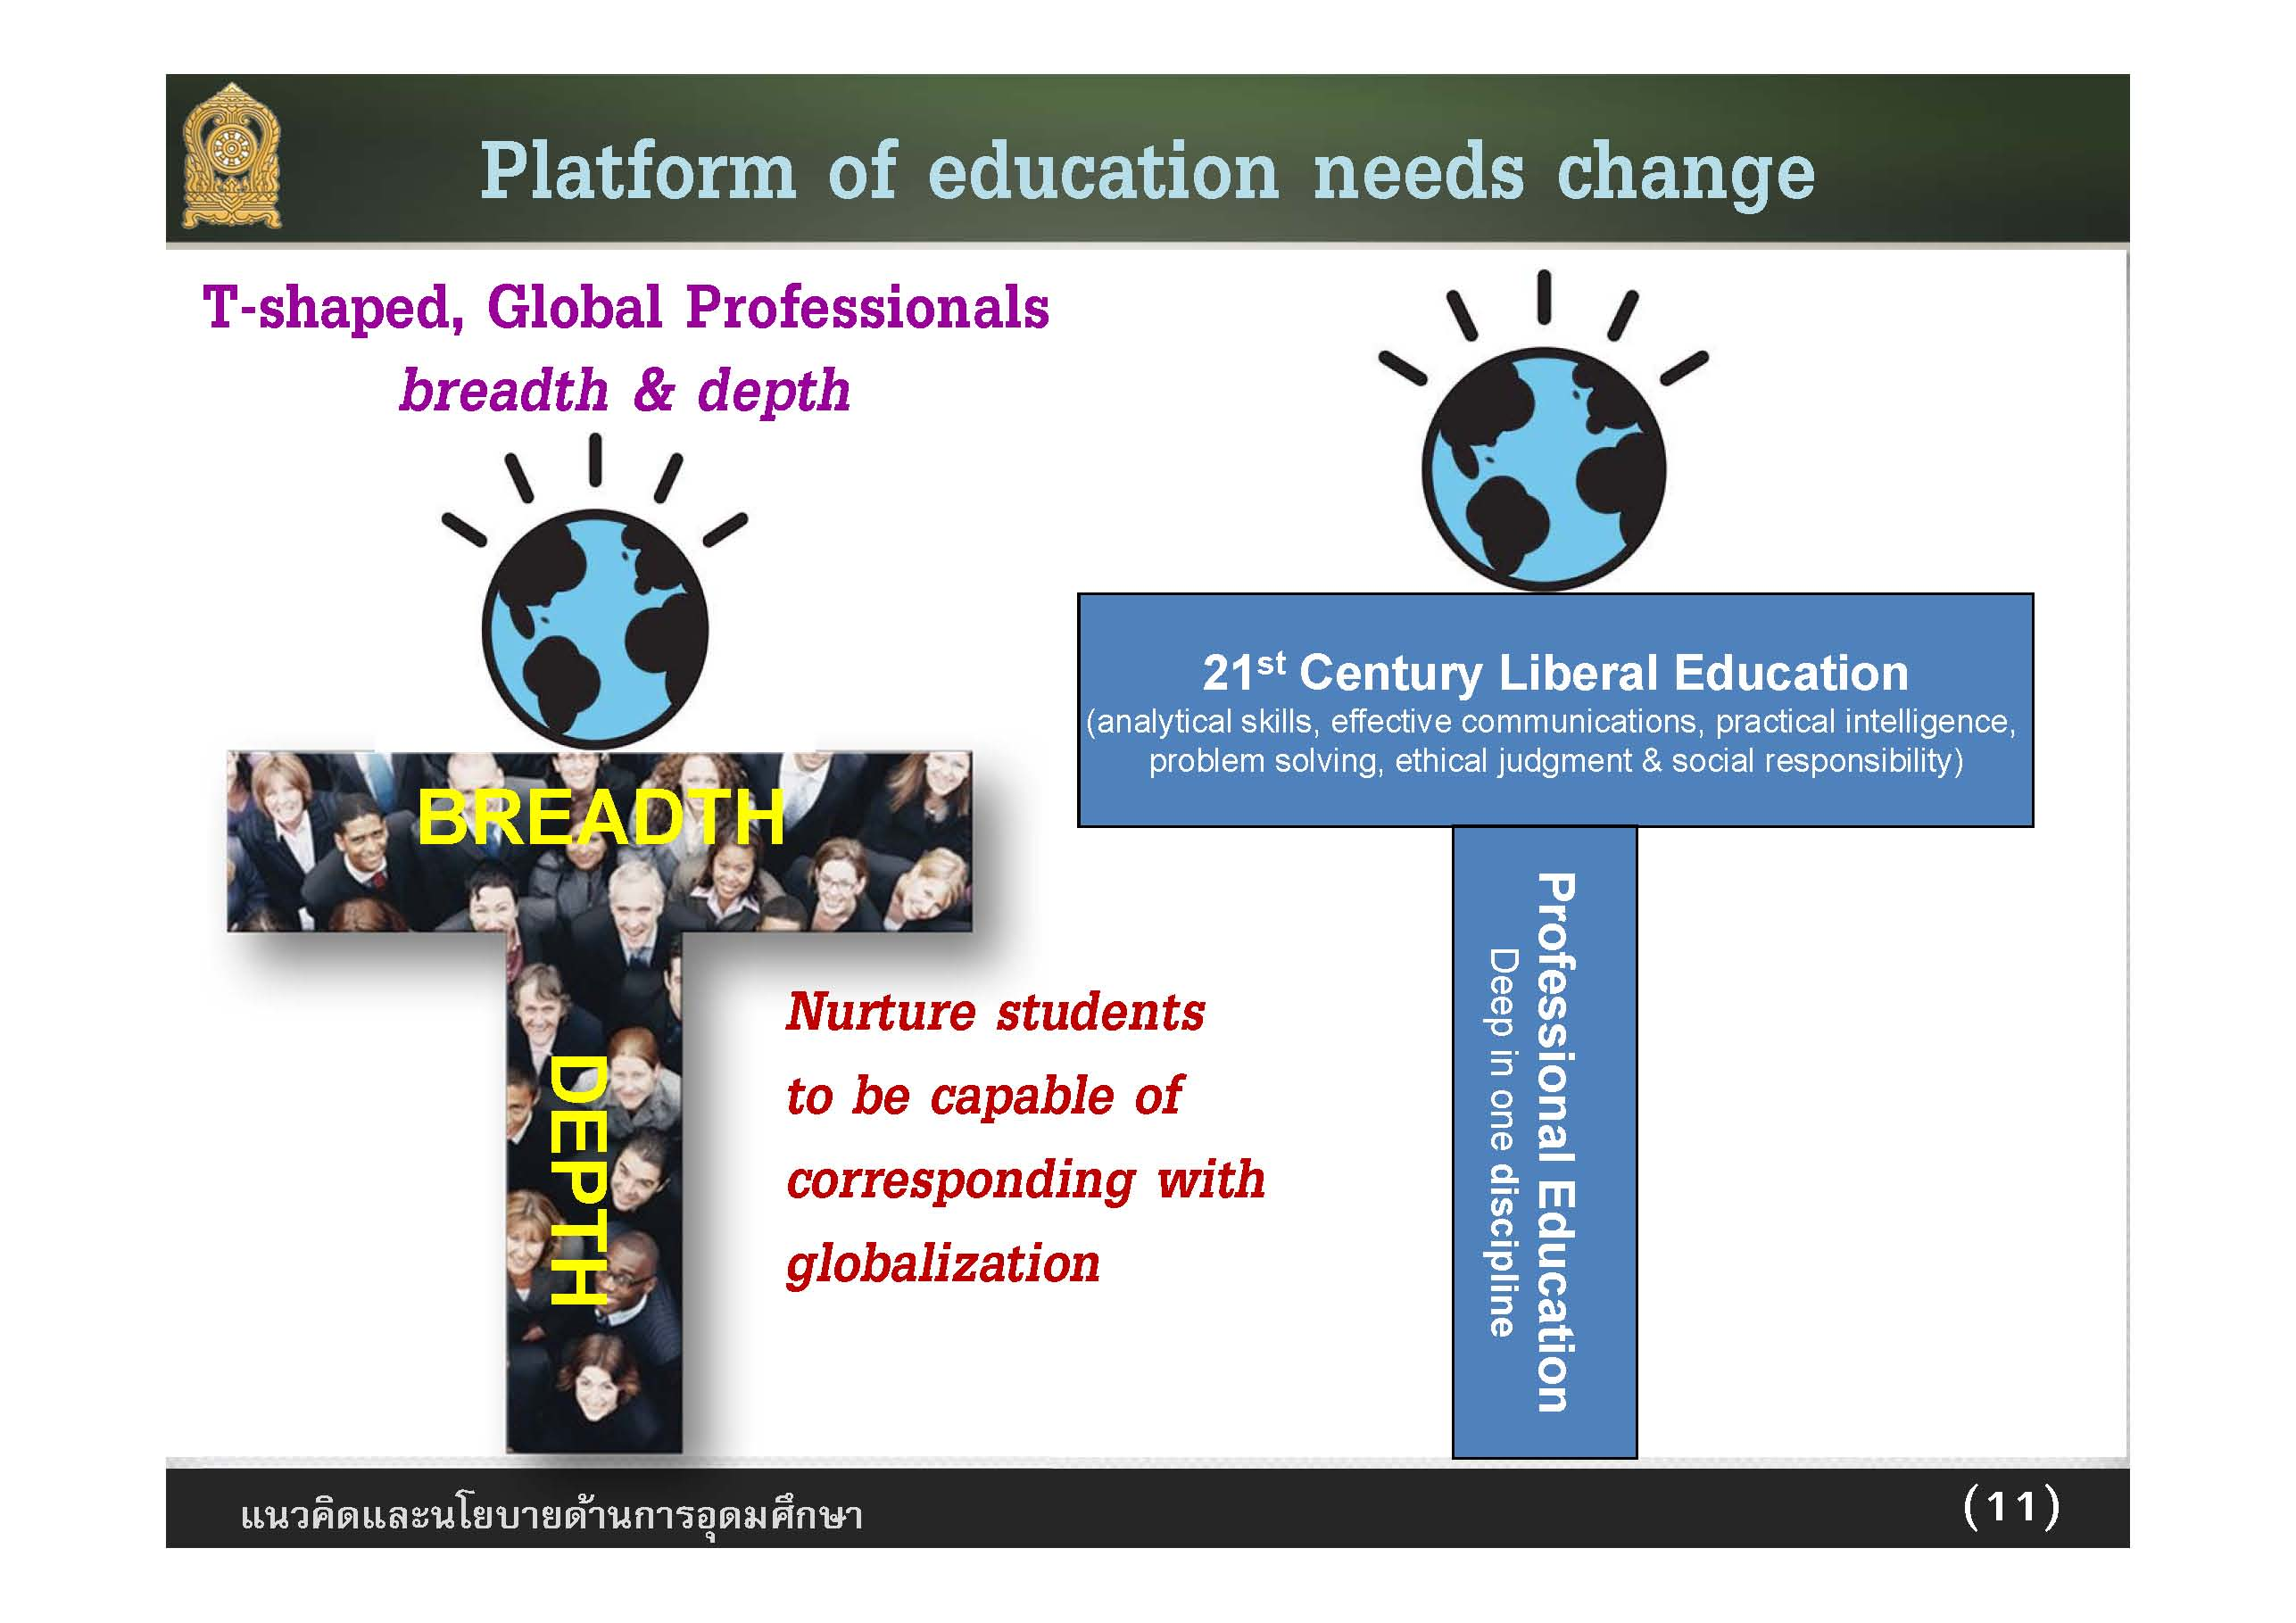
Policy of Deputy Minister of Education (Professor. Udom Kachintorn)
(Page 21)

Slide 22
World Economic Forum Annual Meeting, Davos 23 – 26 January 2018
“skills revolution” could open up a raft of new opportunities.
“If we do not change the way we teach,30 years from now, we’re going to be in trouble”
“Children should be taught “soft skills” like independent thinking, values and team-work.”
“Anything that is routine or repetitive will be automated.”
“We need to break the cultural silos. Too often people put science and the humanities, or science and the arts, in different silos. They are the highest expression of the curiosity and creativity of humanity.”
1. McKinsey Global Institute
2. Jack Ma
3. Minouche Shafik , Director London school of Economic
4. Fabiola Gianotti , Director general of CERN
(Page 22)

Slide 23

Higher Education in Thailand 4.0 Era

